Slide 1
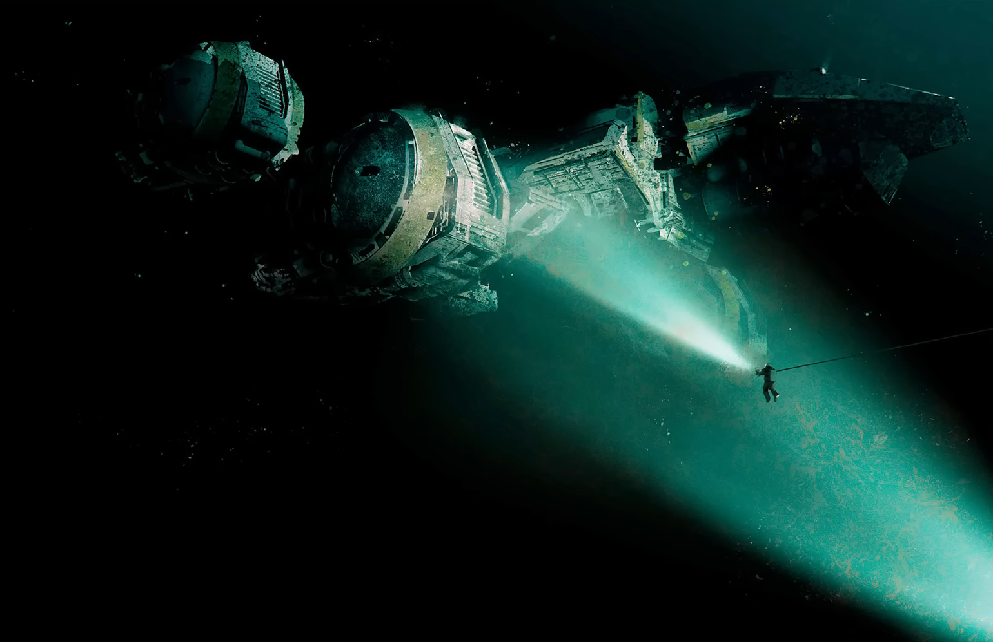
Saving the USCSS Chronus

Slide 2
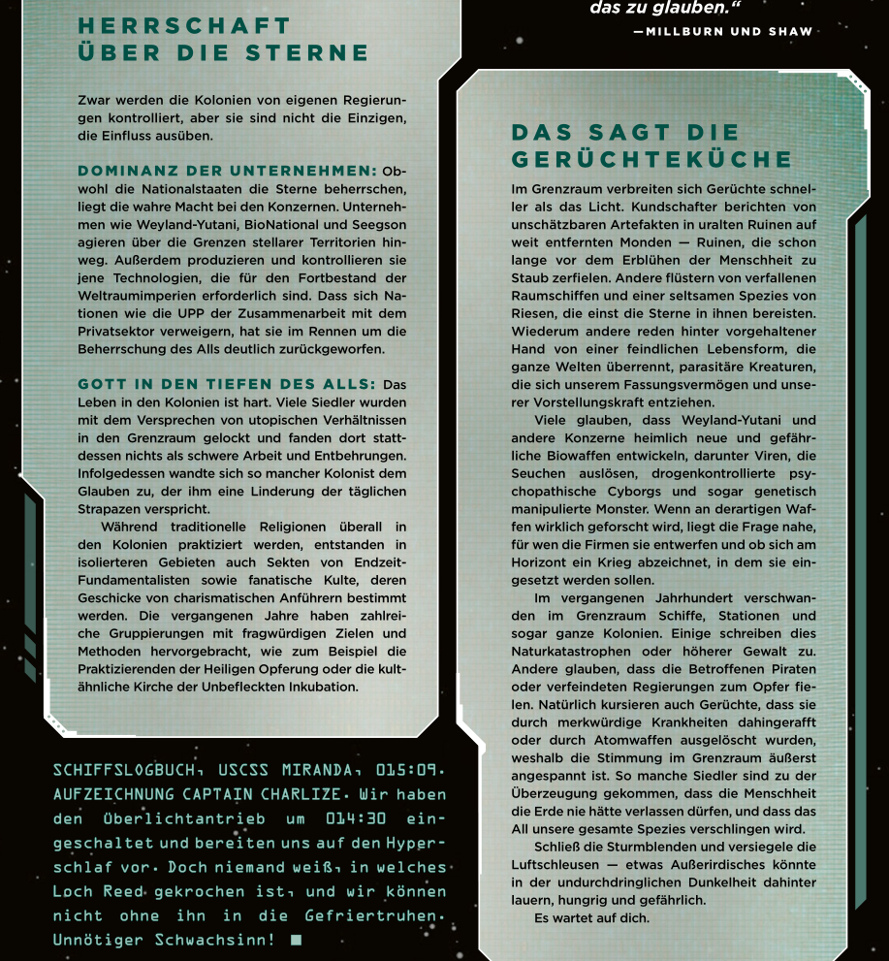

Slide 3
Dominion Among the Stars
While the colonies are formally governed by their own administrations, they are far from the only forces shaping life beyond Earth.
Corporate Supremacy
Although the nation-states claim dominion over the stars, true power lies in the hands of the corporations. Companies such as Weyland-Yutani, BioNational, and Seegson operate far beyond the borders of stellar territories. They produce, control, and safeguard the very technologies required for interstellar expansion and survival.
Nations like the UPP, who refuse to cooperate with the private sector, have paid a heavy price for this stance. Their rejection of corporate collaboration has left them significantly behind in the race for control of space.
God in the Depths of Space
Life in the colonies is harsh. Many settlers were drawn to the frontier by promises of utopian opportunity, only to find exhausting labor, deprivation, and isolation.
As a result, some colonists turned to faith in search of relief from their daily hardships. While traditional religions persist throughout the colonies, isolated regions have also given rise to extremist sects and fanatical cults. These groups are often led by charismatic figures and driven by apocalyptic beliefs.
In recent years, numerous organizations with questionable goals and methods have emerged—ranging from practitioners of so-called holy sacrifice to cult-like movements such as the Church of the Immaculate Incubation.
What the Rumor Mill Says
In the frontier, rumors spread faster than light. Scouts speak of priceless artifacts hidden within ancient ruins on distant moons — ruins that had already crumbled to dust long before humanity ever walked among the stars. Others whisper of derelict spacecraft and a strange race of giants who once traveled effortlessly between the suns.
Still others, behind closed doors and lowered voices, speak of a hostile lifeform — something that burns entire worlds, a parasitic entity that defies comprehension and lies beyond the limits of human imagination.
Many believe that Weyland-Yutani and other megacorporations are secretly developing new and highly dangerous bioweapons: viruses capable of unleashing planetary plagues, drug-controlled psychopathic cyborgs, and even genetically engineered monstrosities. If such weapons are truly being researched, the obvious question follows: for whom are they being designed — and is a new war already looming on the horizon in which they will be unleashed?
A Century of Disappearances
Over the past century, ships, stations, and even entire colonies have vanished from the frontier. Some attribute these losses to natural disasters or overwhelming force. Others believe the victims fell prey to pirates or hostile governments.
Naturally, darker rumors persist — tales of mysterious diseases wiping out populations, or colonies erased by atomic weapons. As a result, tension in the frontier is razor-thin. Some settlers have come to believe that humanity should never have left Earth, and that the void will ultimately consume our species in its entirety.
Seal the blast shutters. Lock the airlocks.
Something alien may be lurking in the impenetrable darkness beyond — hungry, and dangerous…
It is waiting for you.

Slide 4
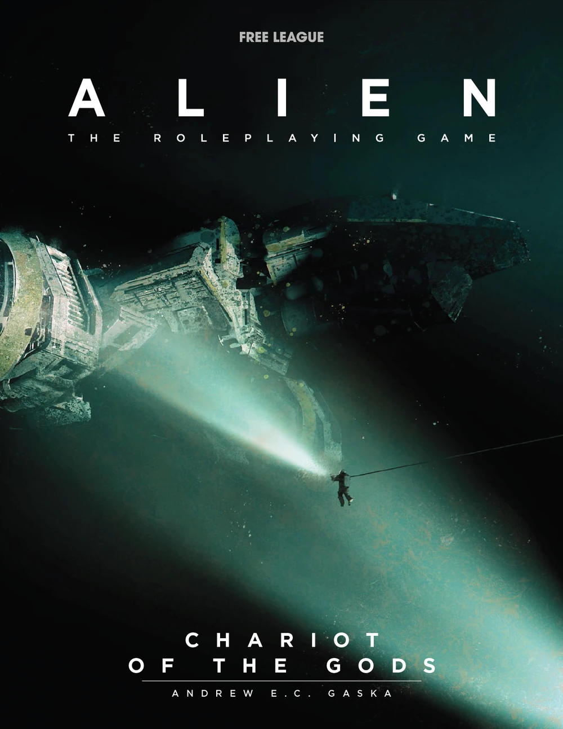

Slide 5
“A Recovery Mission Is Mandatory Under Corporate Policy”
Mission priorities are as follows:
Recover all scientific data and biological samples from the USCSS Cronus.
Transport the Cronus to Anchorhead (Earth) or to another approved Weyland-Yutani facility.
Rescue surviving crew members of the Cronus.
Failure to comply with these priorities will be punished by forfeiture of wages — at minimum.

Slide 6
Situation
As the ship’s AI detects your presence, power systems come online and you hear: “Protocol XVz1x — crew revival sequence initiated.”
A small number of crew members emerge from their cryo-pods, disoriented from hypersleep. It usually takes several hours before they are able to communicate clearly.
Dr. Cooper, the ship’s chief science officer, appears to suffer from severe headaches shortly after being revived.
The AI can, however, assist you in navigating your way to the laboratory.

Slide 7
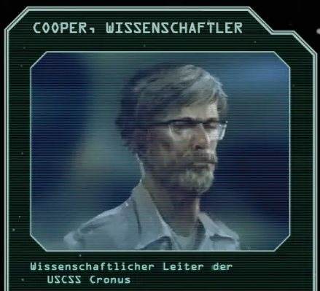
The chief scientific officer of the USCSS Cronus — the person who should, in theory, be able to explain everything that has happened.
Despite the expected effects of hypersleep, Dr. Cooper shows signs of intense neurological distress. He appears to be in severe pain and is, for now, unable to provide meaningful answers

Slide 8
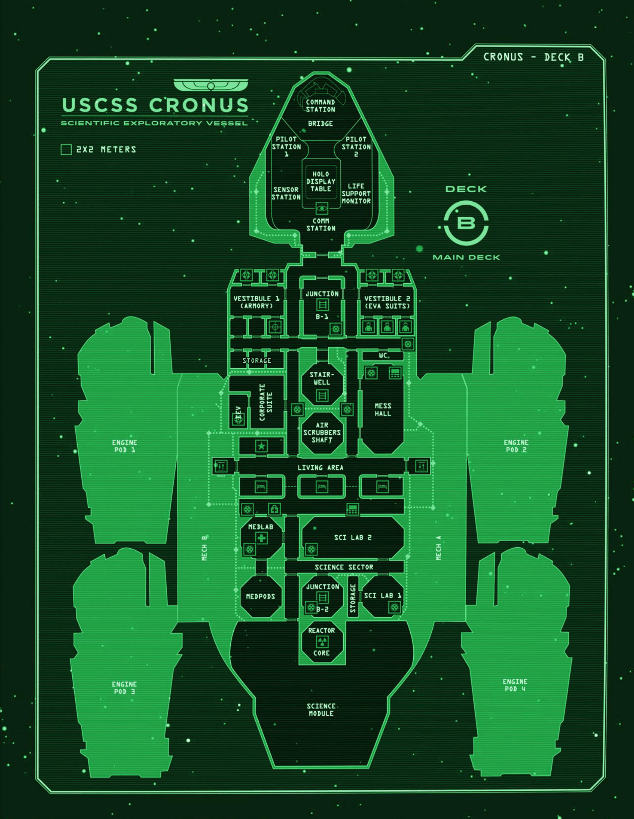

Slide 9

On the Way to the Sci-Lab
You discover a dead creature. Nearby lie a weapon and what appears to be a farewell note.
The creature has unnaturally elongated limbs and a bloated, elongated head, giving it a distinctly non-humanhumanlike appearance.
The corridors outside the laboratories and infirmary bear unmistakable signs of combat, with scorch marks suggesting at least one fire-related incident.

Slide 10
Med Bay
Two glass containment vessels holding an extraterrestrial organism.
A sample tube containing fungus-like nodular material.
A metallic urn containing four organic-looking glass vials filled with a black liquid.
On the desk, you find a medical case containing six syringes filled with a fluid similar to that found in the vials.
In one of the med-pods, there is a creature similar to the one found in the corridor — however, it appears to have been dissected.

Slide 11
Laboratory 1
The room is completely burned out.
The fire does not appear to have been caused by natural means.
Among the melted plastic debris lies a body that, upon closer inspection, resembles the creature found in the corridor.

Slide 12
Laboratory 2
Sorted skeletal remains, not all of which appear to be human — or at least display unusual deformities.
Black, pod-like growths, resembling some form of spore sacs.
A computer terminal containing a folder of research data on the crew members — far more extensive than what would be expected from standard hypersleep monitoring.

Slide 13
RNA Sequencing Data ☺
The folder contains data from multiple sequencing runs, each annotated with date, age, and sex of the patients. In addition, there are several error warnings indicating that problems occurred either during sample collection or processing, likely due to power failures in the ship’s systems. Some samples also appear to have been collected under adverse conditions.
The question remains: How are you supposed to find out what actually happened here…?

